Slide 1

HANDWRITING RECOGNITION FOR AUTHENITCATION
Amrita Vishwa Vidyapeetham
Ettimadai 641112, Coimbatore, Tamil Nadu

Slide 2
MEET OUR TEAMMATES
K S VENKATRAM (CB.SC.U4AIE23236)
SANGGIT SAARAN K C S (CB.SC.U4AIE23247)
SURYA HA (CB.SC.U4AIE23267)
HARIVAARTHAN T D (CB.SC.U4AIE23228)
VISHAL SESHADRI B (CB.SC.U4AIE23260)

Slide 3
CONTRIBUTIONS
VenkatRam K S
Sanggit Saaran K C S
Surya HA
Harivaarthan TD
Vishal Seshadri B
TensorFlow and SoftMax regression handling
Dataset Collection and PPT preparation
Image preparation for input data
Creating Training and Testing datasets
Confusion matrix and ROC curve handling

Slide 4
TABLE OF CONTENTS
S.NO | CONTENTS
1 | INTRODUCTION
2 | TIMELINE
3 | TENSORFLOW
4 | OpenCV
5 | CNN
6 | CODE
7 | CONFUSION MATRIX
8 | ROC CURVE
PAGE NUMBER
4
5
6,7
8
9
10-15
16
17

Slide 5
INTRODUCTION
Handwriting recognition for authentication involves the concept of machine learning and convolutional neural network
The modules which we are using include TensorFlow and OpenCV
This project basically helps us to find the accuracy and whether a particular image is proper or not
We are also plotting an roc curve using a confusion matrix where we predict the accuracy of our training model
The model which we are using is softmax regression model

Slide 6
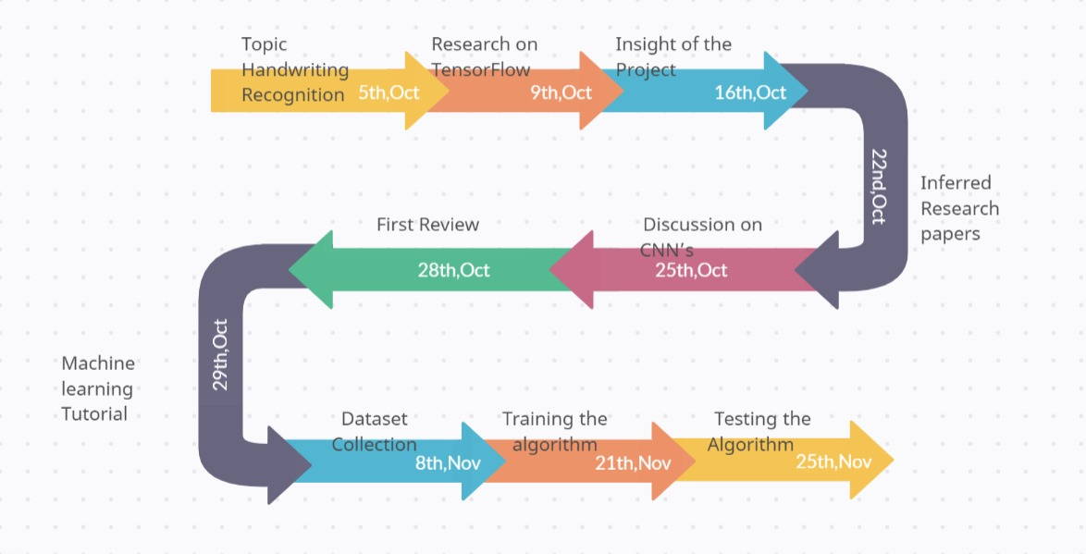
TIMELINE

Slide 7
Tensorflow
TensorFlow is an open-source machine learning library developed by the Google Brain team. It is designed to facilitate the development and deployment of machine learning models, especially deep learning models.
TensorFlow provides a comprehensive set of tools, libraries, and community resources that make it widely used in both research and industry for tasks such as image and speech recognition, natural language processing, and various other machine learning applications.
TensorFlow is highly flexible and can be used for a wide range of machine learning tasks. It supports both traditional machine learning algorithms and deep learning models.
TensorFlow is designed to scale from running on a single CPU to distributed computing across multiple GPUs and even clusters of machines. This scalability is essential for training large and complex models on extensive datasets.
TensorFlow uses a computational graph to represent mathematical operations.

Slide 8
When you load an image into a TensorFlow model, the image is represented as a tensor with three dimensions: height, width, and color channels. TensorFlow operations can then be applied to these tensors for tasks like convolution, activation, and pooling in a convolutional neural network (CNN).
Now let us look into some of the TensorFlow functions:
Tf.constant→ creates a constant tensor
Tf.Variable→ creates a variable tensor that can be modified during training
Tf.placeholder→ used to feeding input values during the execution
Tf.nn function→ contains neural network-related operations
Tf.train → contains functions for training models
Tf.gradientdescentoptimzer()→ this is another function we are using in TensorFlow
The tf.train.GradientDescentOptimizer in TensorFlow is a class that implements the gradient descent
optimization algorithm.

Slide 9
OpenCV
OpenCV, which stands for Open Source Computer Vision Library
OpenCV includes a variety of functions for image processing, such as filtering, edge detection, image transformations, and more.
OpenCV integrates with machine learning frameworks and provides tools for training and using machine learning models. It includes support for deep learning frameworks like TensorFlow.
OpenCV is cross-platform and can be used on various operating systems, including Windows, Linux, and macOS.

Slide 10
Convolution neural network
A supervised deep learning used in computer vision projects
CNN process involves the following steps:
Convolution → the process by which applying the filter and by cross multiplying the image matrix with the filter and creating a feature map
Max Pooling → calculates the maximum value for patches of a feature map and creates a pooled feature map
Flattening → Reorder the pooled feature map in a single column
Full Connection → the flattened vector is used as a input in a fully connected ANN and is how a CNN is connected

Slide 11
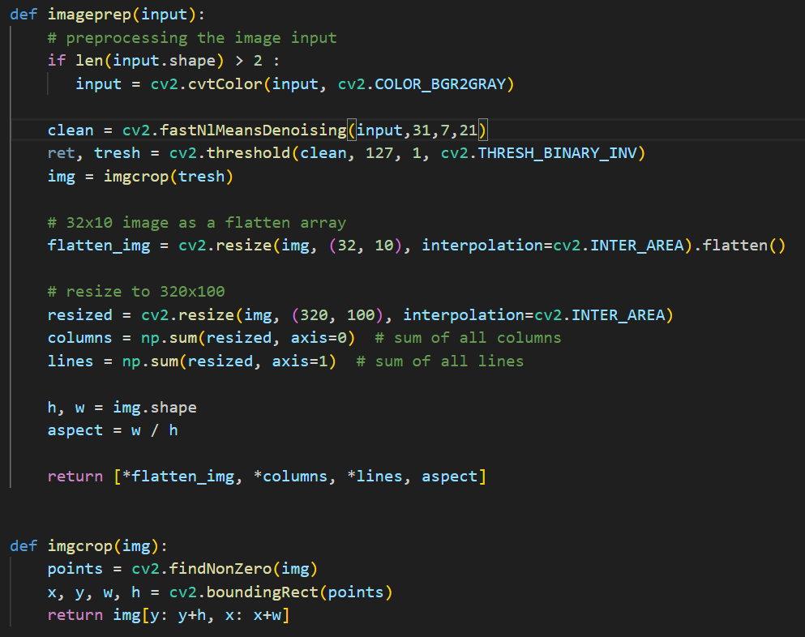
In this process, we are preparing the image so that TensorFlow uses the image to process it.
Input. shape is the function that checks whether the given image is coloured or grayed.
After converting the image to gray we then move on to the function FastN1MeansDenoising where we denoise the noisy images
The next line gives us the threshold where we convert all the images into a binary format using the threshold function. Then we convert the image into its inverse
Next we crop the image and resize it as per the requirements
Then we find the aspect ratio using the rows and columns and we return the flattened image columns
Rows and aspect ratio
,

Slide 12
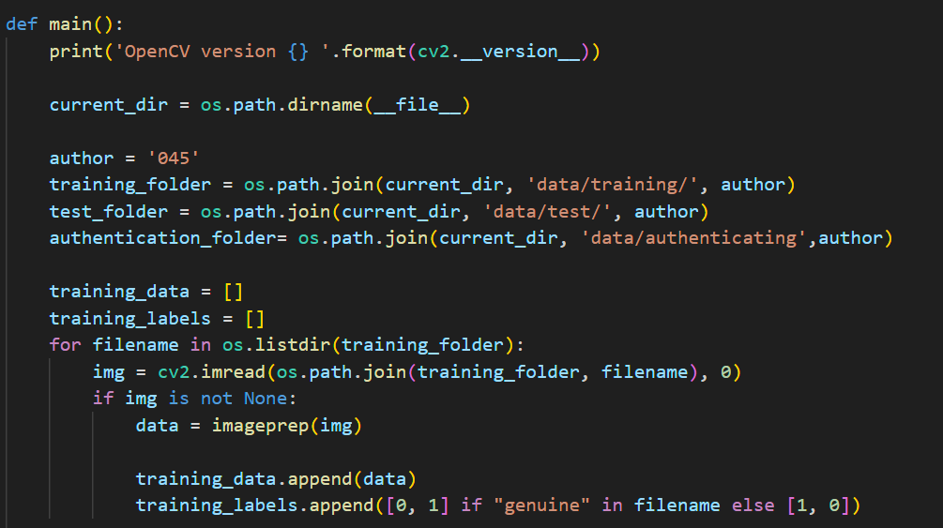
Now the main function is defined where we get the directory in which the programming file is saved
We have to make sure that the directory where the images are stored is the same as where the programming file is stored
We are then giving the directory where the images are stored and giving into the test training and authenticated data.
Then the program goes to the training folder and reads every file using the imread function present in OpenCV and if the image exists it prepares the image using imageprep functions defined by the user
After this, we are appending the images into the training_data and giving 0,1 if the file contains the
name genuine and 1,0 if the file does not contain
the name genuine

Slide 13
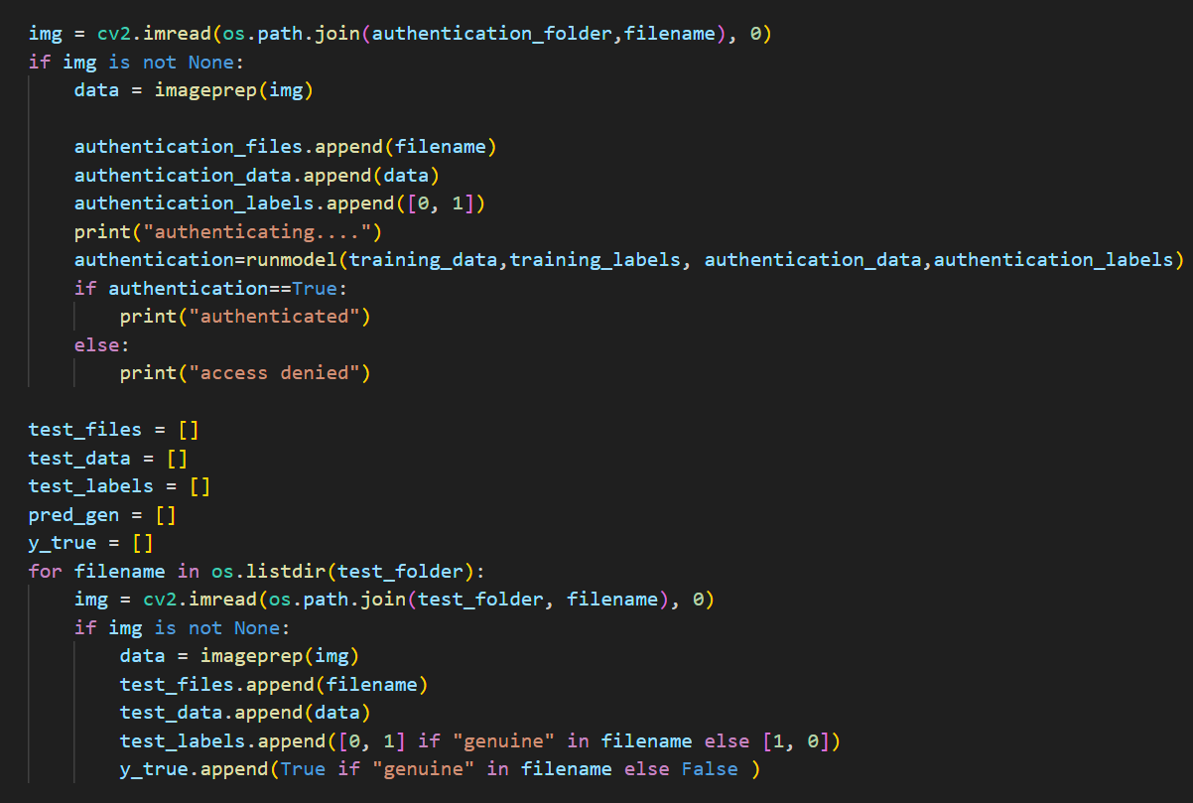
The same process as done in the training part has been implemented for the authentication and the test data
The only extra part added here is the y_true which gives true if the filename is genuine else false

Slide 14
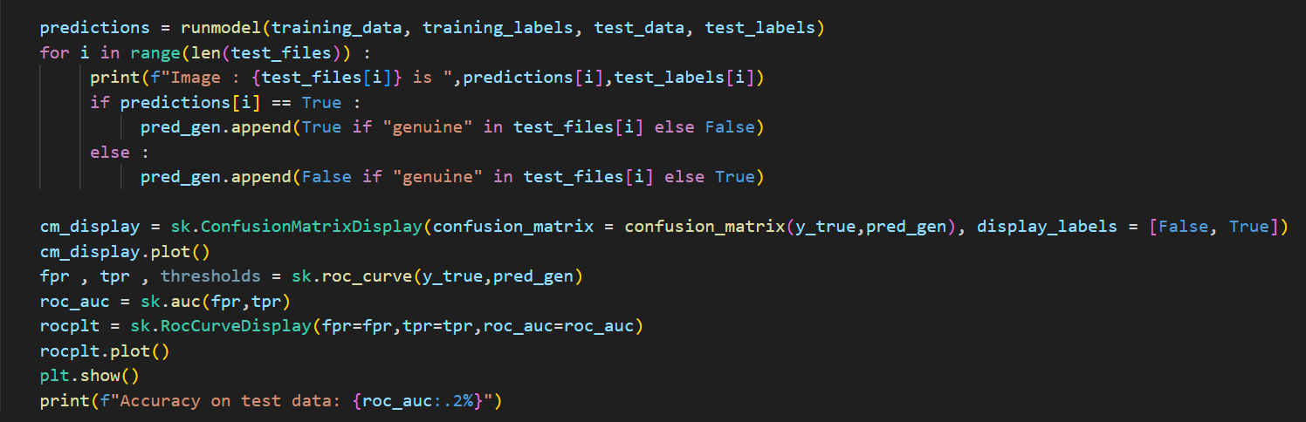
Here we have the predictions file where we use the run model function which we have already created and it helps in finding whether the prediction model identifies the signature properly or not
Then we use a confusion matrix to identify how the prediction model predicts the signatures and gives a matrix which gives how many images are predicted properly and how many images are predicted wrongly
Then we are also plotting a roc curve which receiver operating characteristic curve for displaying a graph between the true positive rater and false positive rate
Then by using matplotlib, we plot the graph of roc and the confusion matrix

Slide 15
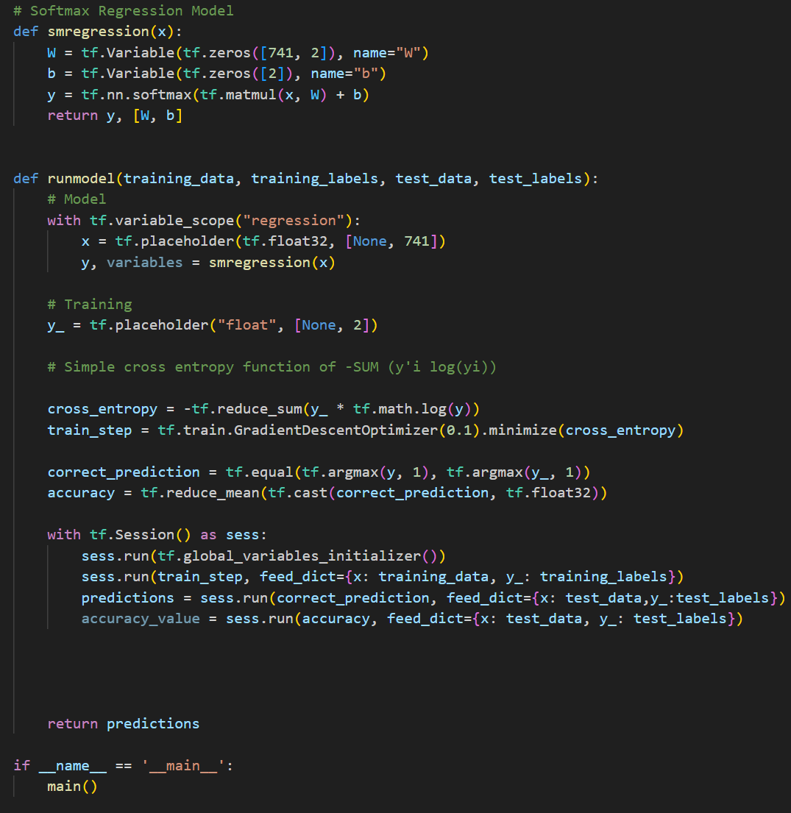
Here we are using the tensorflow part
First, we are creating a tf.Variabble as a matrix so that pixels are read in a matrix format then we multiply the matrix using the nn.softmax function and the tf.matmul function
After this the runmodel-defined function is given where a variable scope for the regression is given
And a placeholder that already gfives a variable scope of a variable which we are going to use later
The smregression part is done again
After this, we go to the entropy loss which si a loss function or cost function which has to be minimized therefore we reduce it and give the mathematical equation of the softmax regression
Then we use the gradient descent optimizer which optimizes the given image where there is a maximum descent to make the code run more efficiently

Slide 16
After this we will find the accuracy of our prediction model
Then we have to run the session and to do so we are using sess.run function which first initially declares all the global variables
Then the train_step which contains the image after the gradient descent optimizer has optimized it and gives data of training and the training labels
Then for prediction, we use the correct_prediction and the test data, test labels to find whether the predictions are correct or not
Then finally we get the accuracy value
And return the predictions

Slide 17
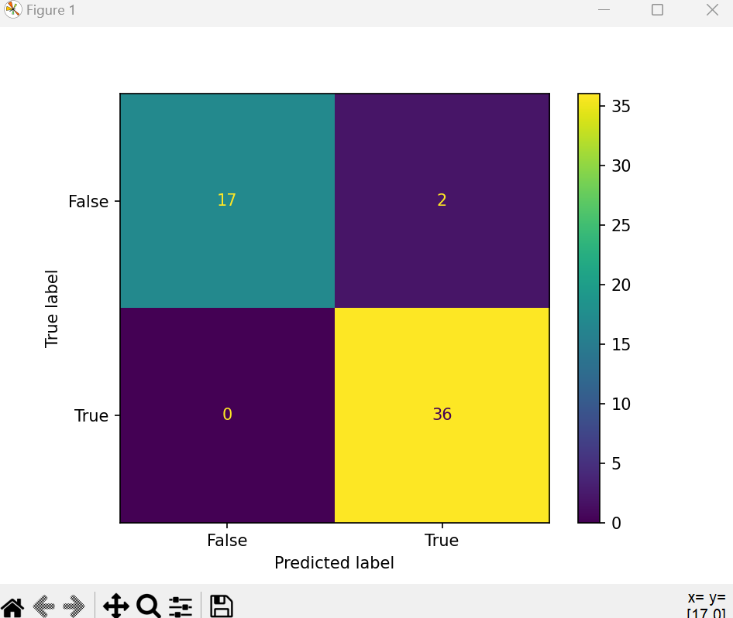
CONFUSION MATRIX
A confusion matrix is a table used in machine learning and statistics to evaluate the performance of a classification algorithm. It is particularly useful when dealing with supervised learning problems, where the goal is to categorize input data into predefined classes or categories.
*True Positive (TP):* Instances where the model correctly predicts the positive class.
False Positive (FP):* Instances where the model incorrectly predicts the positive class (Type I error).
True Negative (TN):* Instances where the model correctly predicts the negative class.
False Negative (FN):* Instances where the model incorrectly predicts the negative class (Type II error).
- *Accuracy:* (TP + TN) / (TP + FP + FN + TN)-
*Precision (Positive Predictive Value):* TP / (TP + FP)- *Recall (Sensitivity, True Positive Rate):* TP / (TP + FN)-
*F1 Score:* 2 * (Precision * Recall) / (Precision + Recall)
These metrics provide insights into the model's ability to correctly classify instances, especially in binary classification problems.

Slide 18
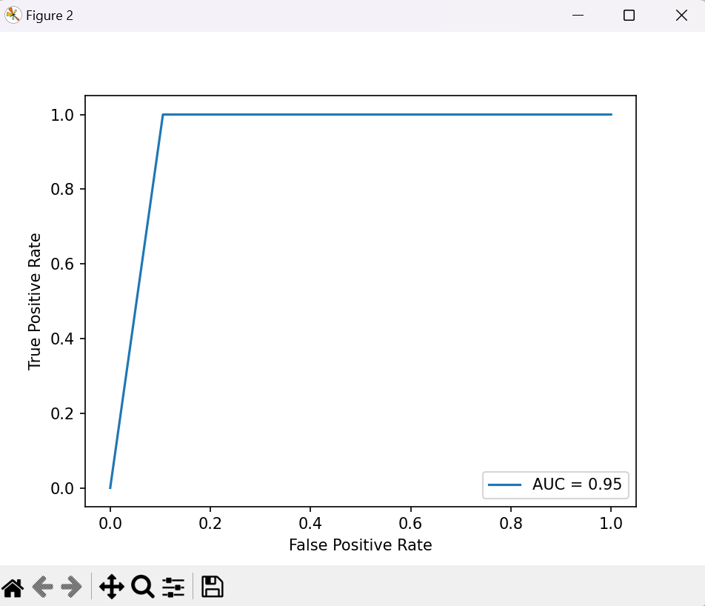
Receiver Operating Characteristics ROC
The Receiver Operating Characteristic (ROC) curve is a graphical representation used in binary classification to evaluate the performance of a classification model across different threshold settings. It plots the True Positive Rate (Sensitivity or Recall) against the False Positive Rate (1 - Specificity) for various threshold values.
- *True Positive Rate (TPR):* This is also known as Sensitivity, Recall, or Hit Rate. It is the ratio of correctly predicted positive instances to the total actual positive instances.
*False Positive Rate (FPR):* This is the ratio of incorrectly predicted positive instances to the total actual negative instances.
The ROC curve is generated by plotting TPR against FPR at different threshold settings. Each point on the curve represents the performance of the model at a particular threshold. A diagonal line from the bottom left to the top right (the line y = x) represents a random guess, and points above this line indicate better-than-random performance.
In practice, a good model will have an ROC curve that is closer to the top-left corner, indicating higher TPR and lower FPR across various threshold values. The area under the ROC curve (AUC-ROC) is often used as a summary metric for model performance, with a higher AUC indicating better overall classification performance
ROC curves are particularly useful when dealing with imbalanced datasets or situations where the cost of false positives and false negatives is different. They provide a comprehensive view of a model's performance across different decision thresholds.

Slide 19
RESULT
In the result we find out the accuracy of our prediction model which on an average comes out to be 93%
We plot a graph of roc curve and the confusion matrix to get a better idea about how the prediction model can be trained to get better results
This code uses CNN and gets the trained data and classifies the signatures

Slide 20

Thank You

